Slide 1
BioRealm – Virtual Zoo & Educational Platform
CSE7101- Capstone Project
Review-1
Batch Number: CSE_92
Under the Supervision of,
Dr. Venkataravana Nayak K
Assistant Professor
School of Computer Science and Engineering
Presidency University
Roll Number | Student Name
20221CSE0064 | DEESHA MITRA
20221CSE0150 | SWARNADEEP DUTTA
Name of the Program: B.TECH COMPUTER SCIENCE & ENGINEERING
Name of the HoD: Dr. Asif Mohamed H B
Name of the Program Project Coordinator: Dr. Jayavadivel Ravi
Name of the School Project Coordinators: Dr. Sampath A K , Dr. Geetha A

Slide 2
Problem Statement Number:
Organization: Ministry of Environment
Category (Hardware / Software / Both) : Software
Problem Description: The Limitations of Traditional Wildlife EducationEthical Concerns: Traditional zoos involve captivity, often leading to "Zoochosis" (stress behavior) and ethical debates regarding animal rights.Accessibility Barriers: Physical zoos are limited by geography, travel costs, and seasonal weather, making them inaccessible to many students (digital divide).Passive Learning: Traditional documentaries and textbooks offer passive observation rather than active, exploratory engagement.Safety & Logistics: Physical interaction with wildlife poses safety risks (zoonosis/injury) and high operational costs for maintenance.

Slide 3
Content
Problem Statement
Objectives
Background and Related work for title Selection
Analysis of Problem Statement
Innovation or Novel Contributions
Git-hub Link
Timeline of the Project
References

Slide 4
Analysis of Problem Statement
Technical & Educational Challenges Addressed
Performance vs. Accessibility:
Challenge: High-quality 3D models lag on web browsers.
Analysis: A balance was needed between visual quality and load times
Pedagogical Depth:Challenge: "Compassion Fade" occurs when users view animals passively.
Analysis: Active interaction (clicking hotspots, answering questions) is required to retain facts about diets, habitats, and conservation status.
Technological Sustainability:
Challenge: Heavy frameworks (React/Angular) increase complexity and file size.
Analysis: A "Vanilla" (framework-free) approach was chosen to ensure the platform remains lightweight and easy to maintain..

Slide 5
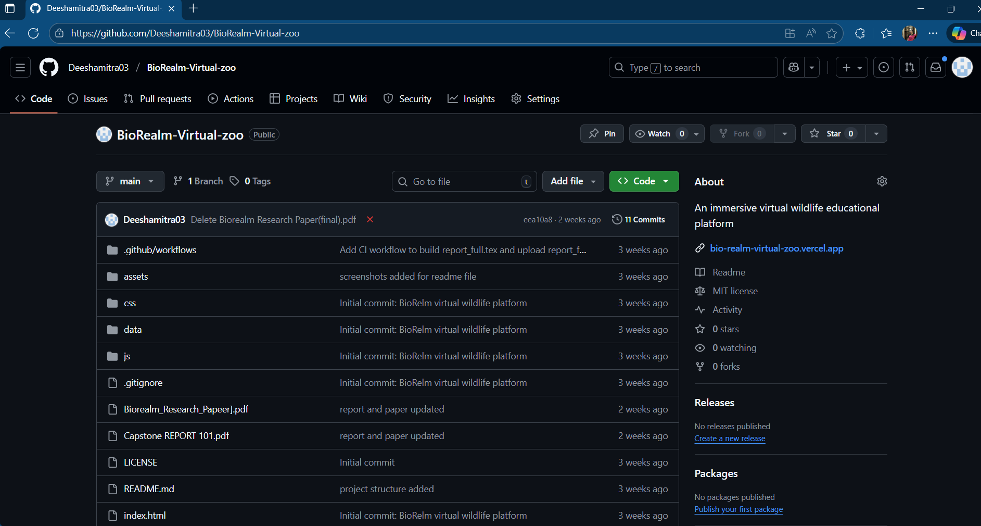
Github Link
Github Link:
Deeshamitra03/BioRealm-Virtual-zoo: An immersive virtual wildlife educational platform

Slide 6
Background and Related Work
Evolution of Virtual Zoos
Existing Technologies:
Raichurkar et al. (2025): Used Unreal Engine 5. High visual fidelity but required expensive hardware/GPUs.
Ahmed & Hossain (2020): VR Chiriyakhana using Google Cardboard. Good for immersion but required a headset.
2D Text/Images: Accessible but lacks engagement and emotional connection.
Identified Research Gaps:
The Hardware Bottleneck: High-quality VR usually excludes users with low-end devices.
Passive Models: Most existing virtual zoos are just video players; they lack interactive assessment.
Pedagogical Lack: Many existing apps focus on visuals but fail to test knowledge retention.

Slide 7
Innovation and Novel Contributions
What Makes BioRealm Unique?
WebGL-Based 360° Rendering: Uses Pannellum.js to map 2D equirectangular images onto a 3D sphere, allowing immersive VR without a headset.
Green/Zero-Cost IT Strategy:
Built using 100% Open Source tools (VS Code, Blender, GIMP).
Hosted on GitHub Pages (Zero server cost).
Low carbon footprint compared to physical tourism.
Hybrid "Edutainment" Model: Combines a "Virtual Safari" (exploration) with a logic-based "Ecosystem Quiz" (assessment) in a Single Page Application (SPA).
Optimized for Low Bandwidth: Implements image compression and lazy loading, making high-fidelity education accessible on mobile networks (3G/4G) in rural areas.

Slide 8
Timeline of the Project (Gantt Chart)
Phase 1: Planning & Design (Aug - Sept 2025)
Weeks 1-2: Problem identification and topic selection.
Weeks 3-4: Literature review and identifying the technical stack.
Weeks 6-7: System Design (UI Wireframing, Database Schema).
Week 8: Material Collection (Sourcing 360° images and audio assets).
Phase 2: Implementation & Testing (Oct - Nov 2025)
Weeks 9-10: Frontend development (HTML/CSS/Responsive Layouts).
Weeks 10-11: Logic Implementation (Integrating Pannellum & Quiz Logic).
Week 13: Testing (Unit testing, Cross-browser checks, Mobile performance).
Week 14: Deployment to GitHub Pages and Final Documentation.

Slide 9
References (IEEE Paper format)
Raichurkar, S., et al. (2025). Virtual Zoo: Immersive Digital Wildlife. International Journal of Advanced Research in Science, Communication and Technology.
Ahmed, T. & Hossain, M.J. (2020). VR Chiriyakhana: A Virtual Zoo Using Google Cardboard. SN Computer Science.
Sukmawati, F., et al. (2023). Design of Virtual Reality Zoos Through IoT. Revue d'Intelligence Artificielle.
Lugosi, Z. & Lee, P.C. (2021). A Case Study Exploring the Use of Virtual Reality in the Zoo Context. Animal Behavior and Cognition.
Pimentel, D. & Kalyanaraman, S. (2022). The effects of embodying wildlife in virtual reality on conservation behaviors. Scientific Reports.

Slide 10
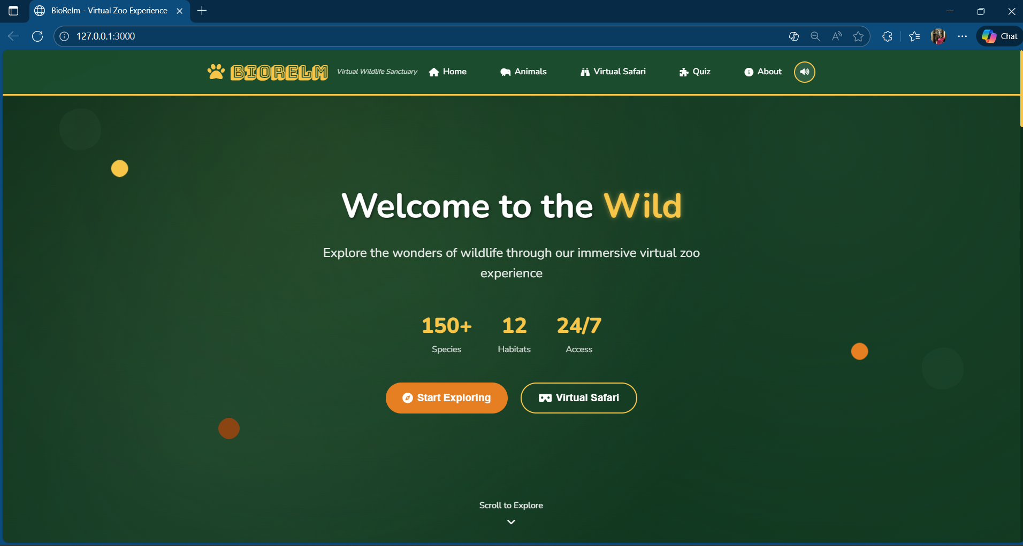
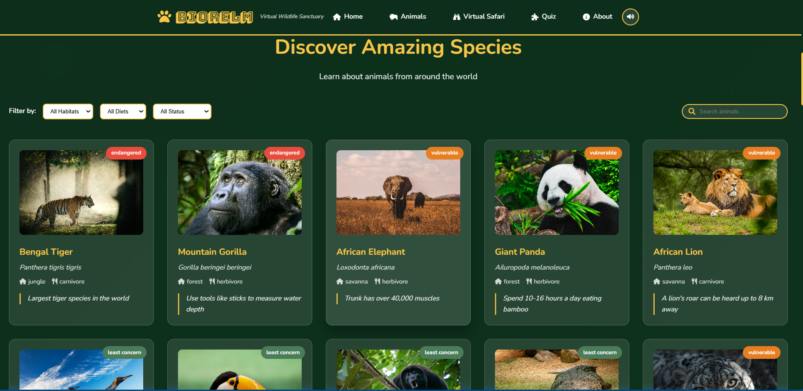
USER INTERFACE – (welcome and animals page)

Slide 11
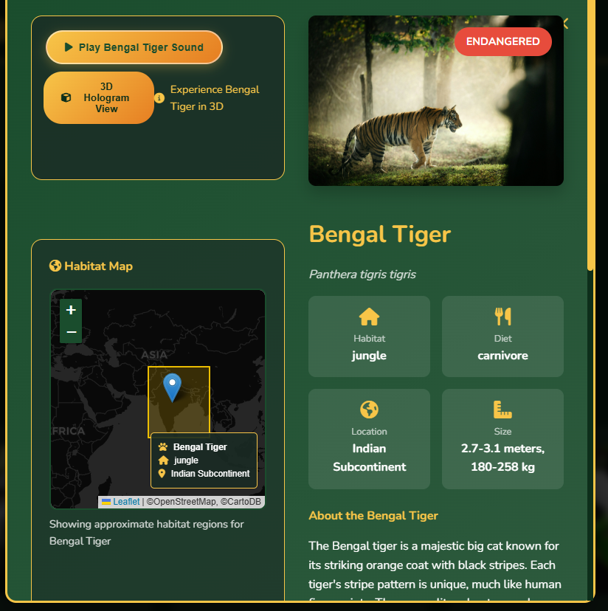
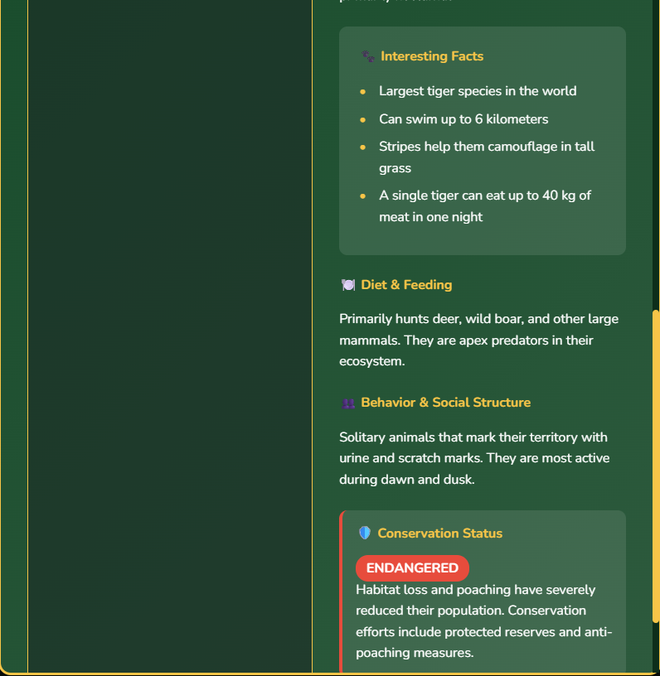
USER INTERFACE – (animals details page)

Slide 12
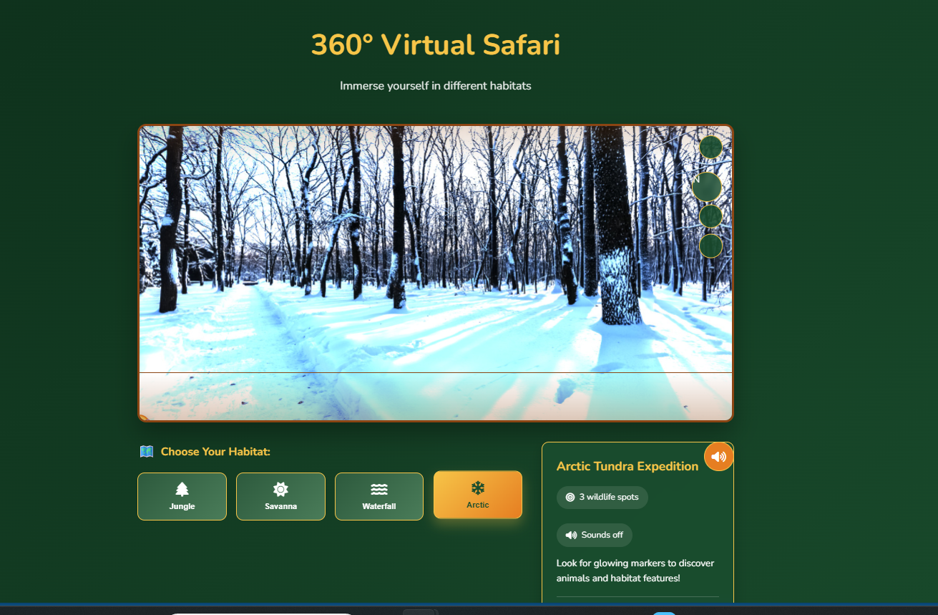
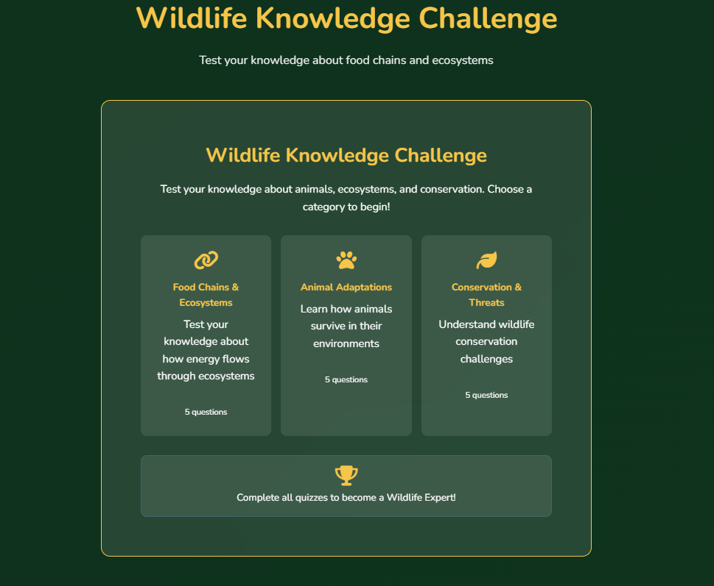
USER INTERFACE – (360 degree safari & quiz page)

Slide 13
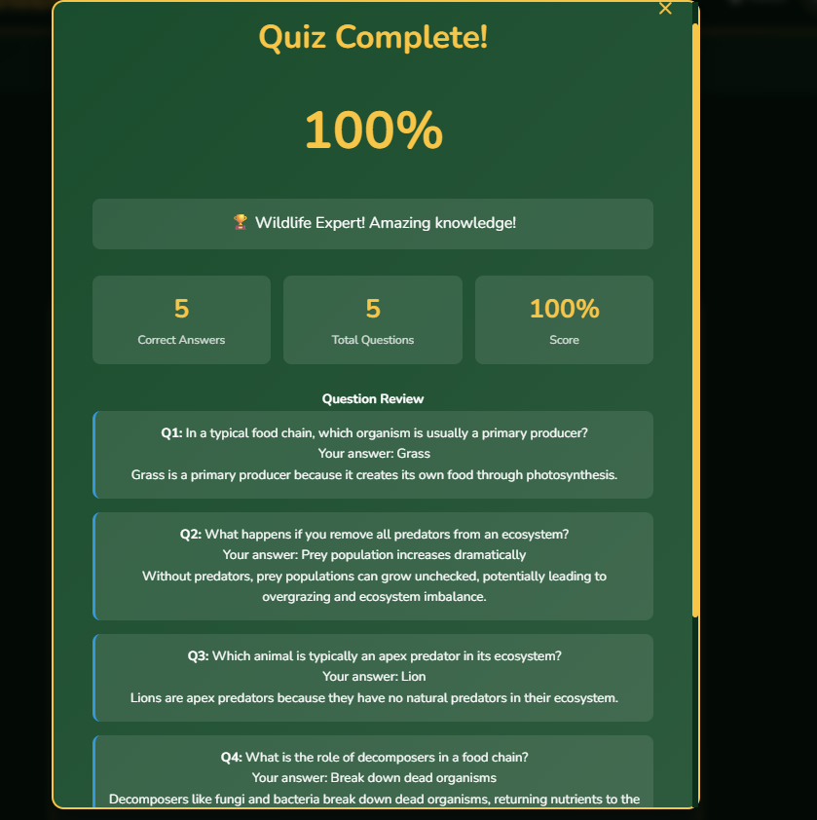
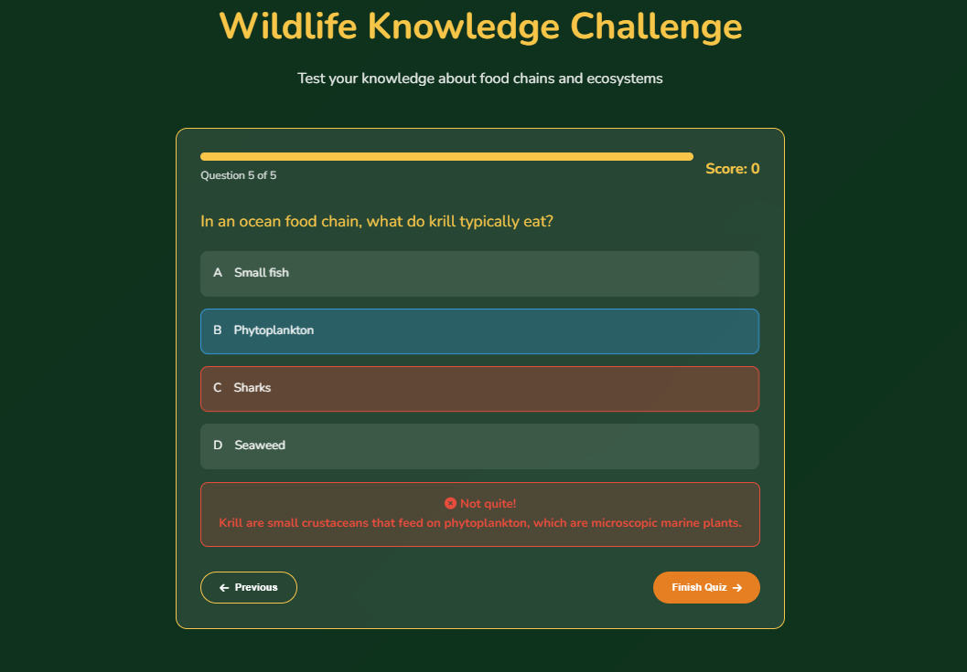
USER INTERFACE – (Quiz summary page)

Slide 14


